Slide 1
Sets
CSE 2213 – Discrete Mathematics

Slide 2
We know about sets, right?

Slide 3

Sets
A set is a collection of unordered objects.
$V=\left\{a,e,i,o,u\right\}$ is the set of all English vowels
$a∈V$ means $a$ is a member of $V$
$S=\{1,2,3,4,5,6,7,8,9,10\}$ is the set of all positive integers less than or equal to ten

Slide 4
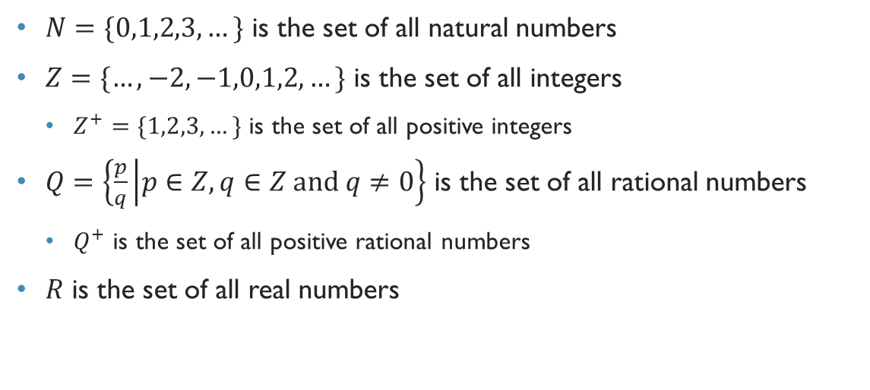
Some important sets
$N=\{0,1,2,3,…\}$ is the set of all natural numbers
$Z=\{…,−2,−1,0,1,2,…\}$ is the set of all integers
$Z^{+}=\{1,2,3,…\}$ is the set of all positive integers
$Q=\left\{\frac{p}{q} | p∈Z,q∈Z \text{and} q≠0\right\}$ is the set of all rational numbers
$Q^{+}$ is the set of all positive rational numbers
$R$ is the set of all real numbers

Slide 5
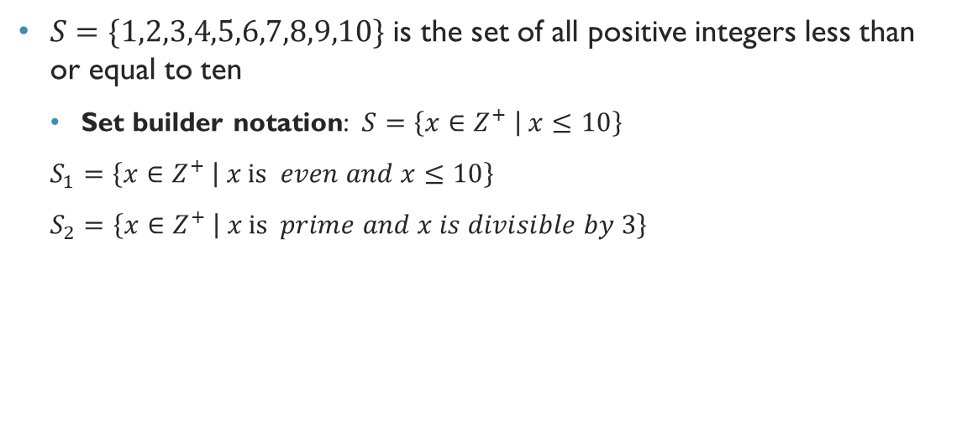
Set builder notation
$S=\{1,2,3,4,5,6,7,8,9,10\}$ is the set of all positive integers less than or equal to ten
Set builder notation: $S=\left\{x∈Z^{+} | x≤10\right\}$
$S_{1}=\left\{x∈Z^{+} | x \text{is} even and x≤10\right\}$
$S_{2}=\left\{x∈Z^{+} | x \text{is} prime and x is divisible by 3\right\}$
Notes:
Set Builder Notation ==> {x: where x is *condition*}

Slide 6
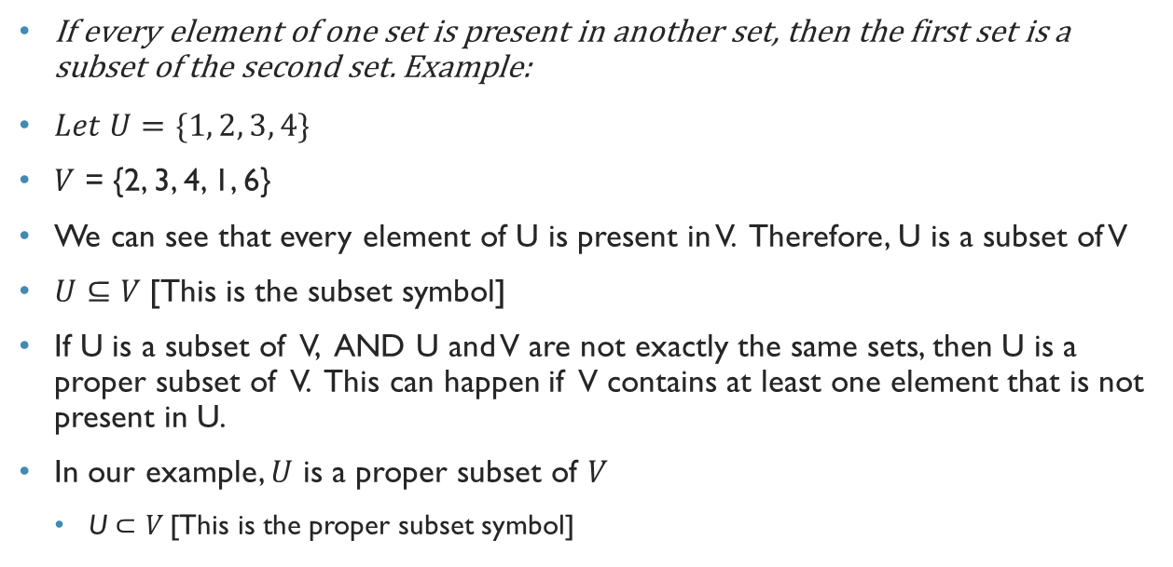
Subsets
If every element of one set is present in another set, then the first set is a subset of the second set. Example:
$Let U=\{1, 2, 3, 4\}$
$V$ = {2, 3, 4, 1, 6}
We can see that every element of U is present in V. Therefore, U is a subset of V
$U⊆V$[This is the subset symbol]
If U is a subset of V, AND U and V are not exactly the same sets, then U is a proper subset of V. This can happen if V contains at least one element that is not present in U.
In our example, $U$ is a proper subset of $V$
U $⊂V$[This is the proper subset symbol]

Slide 7

Empty Set
$∅$
{ }
{$∅$}

Slide 8
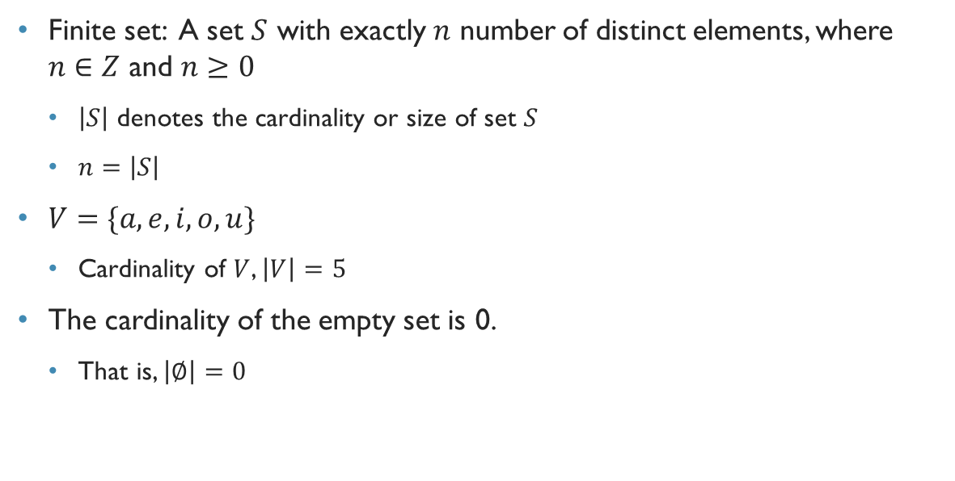
Cardinality of finite sets
Finite set: A set $S$ with exactly $n$ number of distinct elements, where $n∈Z$ and $n≥0$
$\left|S\right|$ denotes the cardinality or size of set $S$
$n=\left|S\right|$
$V=\{a,e,i,o,u\}$
Cardinality of $V$, $\left|V\right|=5$
The cardinality of the empty set is 0.
That is, $\left|∅\right|=0$

Slide 9
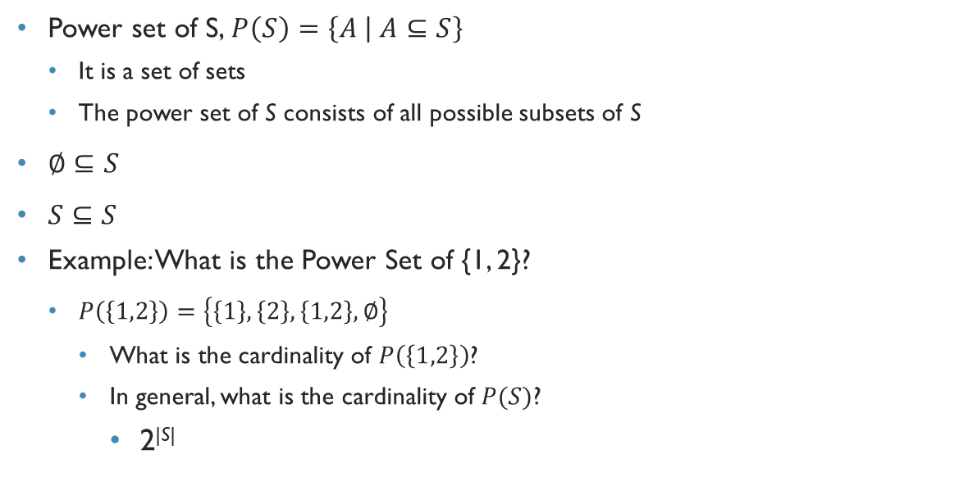
Power set
Power set of S, $P\left(S\right)=\left\{A | A⊆S\right\}$
It is a set of sets
The power set of S consists of all possible subsets of S
$∅⊆S$
$S⊆S$
Example: What is the Power Set of {1, 2}?
$P\left(\left\{1,2\right\}\right)=\left\{\left\{1\right\}, \left\{2\right\}, \left\{1,2\right\},∅\right\}$
What is the cardinality of $P\left(\left\{1,2\right\}\right)$?
In general, what is the cardinality of $P(S)$?
2^{|S|}
Notes:
Power Set of {a, b, c}?
{{}, {a}, {b}, {c}, {a, b}, {a, c}, {b, c}, {a, b, c}}

Slide 10
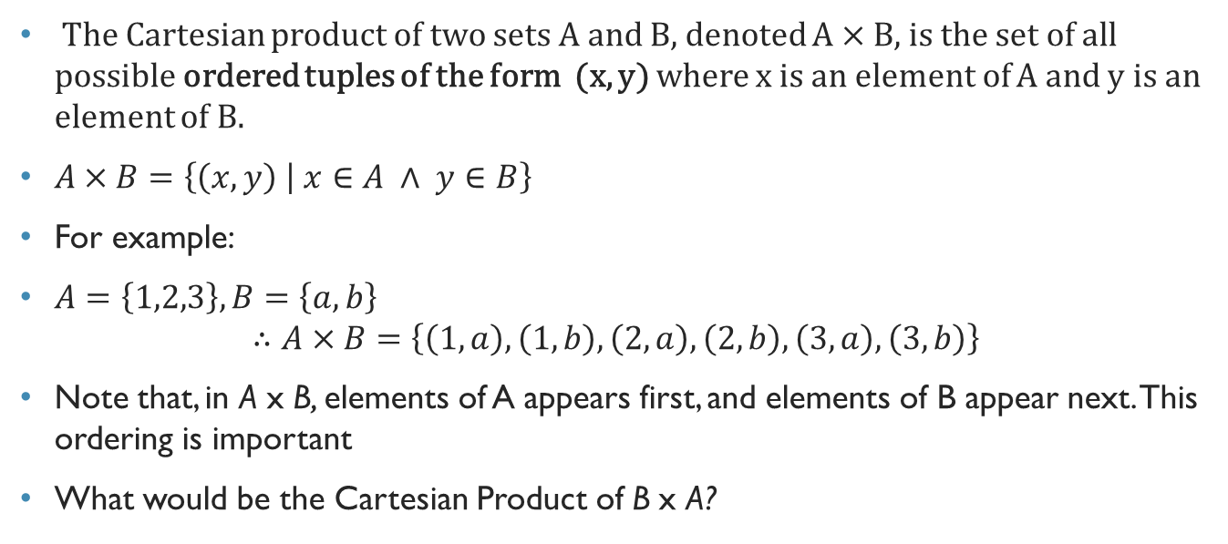
Cartesian product
The Cartesian product of two sets A and B, denoted A × B, is the set of all possible ordered tuples of the form (x, y) where x is an element of A and y is an element of B.
$A×B=\left\{\left(x,y\right) | x∈A ∧ y∈B\right\}$
For example:
$A=\left\{1,2,3\right\},B=\left\{a,b\right\}$ $∴A×B=\left\{\left(1,a\right),\left(1,b\right),\left(2,a\right),\left(2,b\right),\left(3,a\right),\left(3,b\right)\right\}$
Note that, in A x B, elements of A appears first, and elements of B appear next. This ordering is important
What would be the Cartesian Product of B x A?

Slide 11
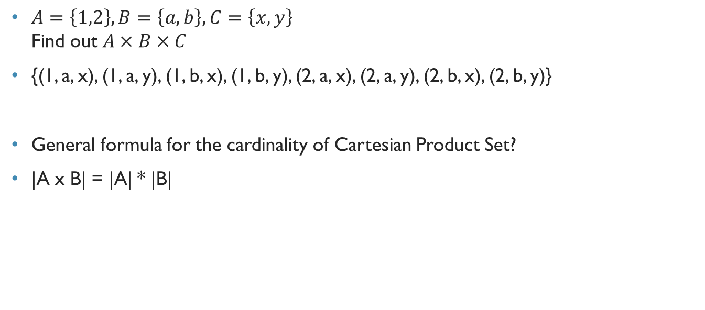
Cartesian product
$A=\left\{1,2\right\},B=\left\{a,b\right\},C=\left\{x,y\right\}$ Find out $A×B×C$
{(1, a, x), (1, a, y), (1, b, x), (1, b, y), (2, a, x), (2, a, y), (2, b, x), (2, b, y)}
General formula for the cardinality of Cartesian Product Set?
|A x B| = |A| * |B|

